Slide 1
動詞的用法
表動作、狀態的詞語稱為動詞。動詞用於句子當中，有及物動詞(Verb transitive)與不及物動詞(Verb intransitive) 之分。當及物動詞使用時，後面一定要直接接受詞。
＊ He didn’t move.
＊ He didn’t move the desk.
動詞的形式
動詞的形式須配合以下幾項因素做變化：
發生於何時 ?
主詞是第幾人稱 ?
主詞是單數還是複數 ?
＊ I had a headache yesterday. (have→had)
＊ My brother likes surfing. (like→likes)

Slide 2
動詞與句型
所謂的句型，就是以主詞S、動詞V、受詞O、補語C四個要素
來表示句子的結構。
SV ＊ The store opens at ten.
SVC ＊ The movie was funny.
SVO ＊ We cleaned the classroom.
SVOO ＊ My father bought me a watch.
SVOC ＊ They made me angry.
SVO+to/for+O ＊ My uncle gave his watch to me.
There+be 動詞+S ＊ There is a cat under the table.

Slide 3
測驗
Check 1 注意句中畫線部分的動詞，將各句譯成中文。
A big car stopped in front of my house.
The driver stopped the car.
Don’t play on the street.
Let’s play tennis after school.
Check 2 請說出畫線部分是補語還是受詞。
Did you get my fax?
The teacher got angry with him.
We became friends at university.
He has a lot of friends all over the world.
Check 3 請指出句中的受詞。
Ms. Kim teaches us math.
He gave me some magazines.
I got a letter from him.
Check 4 請將下列句子譯成中文。
We call the dog Max.
Our coach made her the team’s captain.
You will find this book easy.

Slide 4
動詞與時態

Slide 5
現在式
表示現在狀態 ＊ l love chocolate ice cream.
表示現在反覆動作 ＊ I always drink coffee at breakfast.
表示一般事實 ＊ The earth goes around the sun.
現在進行式
表示動作正在進行 ＊ Jack is playing tennis with Bob now. ＊ Jack plays tennis every Sunday. ~ 現在式

Slide 6
過去式
表示過去狀態 ＊ The store was full of young people last week.
表示過去反覆動作 ＊ I usually rode my bicycle to school.
表示動作過去發生過一次 ＊ We went to a concert last night.
過去進行式
表示過去某個時間點動作正在進行 ＊ I was watching TV around noon. ＊ I was coughing all night long.

Slide 7
未來式
以 will 表示單純未來、意志未來 ＊ My brother will be twenty next year. ＊ I will give you my answer tomorrow.
以 be going to 表示主詞的計畫、詢問對方的計畫、確實會發生的事 ＊ I’m going to buy a digital camera. ＊ Are you going to study abroad next year? ＊ It’s going to rain.
未來進行式
以 will be V-ing 表示未來某個時間點進行中的動作、 未來某個時間點預定要做的動作 ＊ We will be playing tennis at this time tomorrow. ＊ I will be meeting him at the airport next week.

Slide 8
測驗
Check 1 請將括弧內的動詞改為現在式或現在進行式。
This orange (taste) bad; it (be) not good to eat.
Mary (play) a piece by Bach on the piano now; she (like) music very much.
The sun (rise) in the east and (set) in the west.
My sister usually (wear) contact lenses, but she (wear) glasses today.
Check 2 請將括弧內的動詞改為適當形式。
I wanted to be a sailor when I (be) a boy.
My grandfather often (tell) me interesting stories in my childhood.
He ran to the station and (catch) the last train.
I (watch) TV when you called me.
Check 3 請配合中文語意，在空格內填入適當的英文。
「好痛！我切到手指了！」「我去拿急救箱給你！」 “Ouch! I cut my finger!” “I □ get a first-aid kit for you!”
今年八月我會搬去西班牙，所以我需要學西班牙語。 I need to learn Spanish because I □ □ □ move to Spain this August.
明天的這個時候，他們會舉行宴會吧！ At this time tomorrow they □ □ having a party.

Slide 9
現在完成式
現在完成式是將過去與現在的狀況連結，因此使用現在完成式時，與現在的狀況關聯性甚高。
形式：「have/has＋過去分詞」
表示完結或結果 ＊ I have already spent all my money. ＊ Henry has just finished his homework.
表示經驗 ＊ I have visited London twice. ＊ Have you ever climbed Mt. Ali?
表示持續 ＊ We have lived in this house since 1992. ＊ I have known Greg for 20 years.

Slide 10
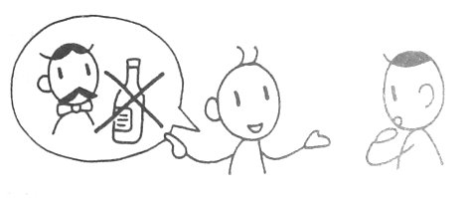
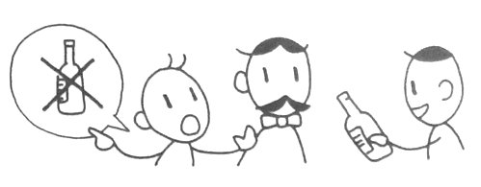
過去式與現在完成式
＊ My father gave up alcohol.
＊ My father has given up alcohol.
會話中常用的縮寫：
I have→ I’ve you have→ you’ve he has→ he’s she has→ she’s
we have→ we’ve they have→ they’ve
現在完成進行式
形式：「have/has＋been＋V-ing」
表示動作持續 ＊ I have been doing this puzzle for 30 minutes. ＊ How long have you been waiting here?

Slide 11
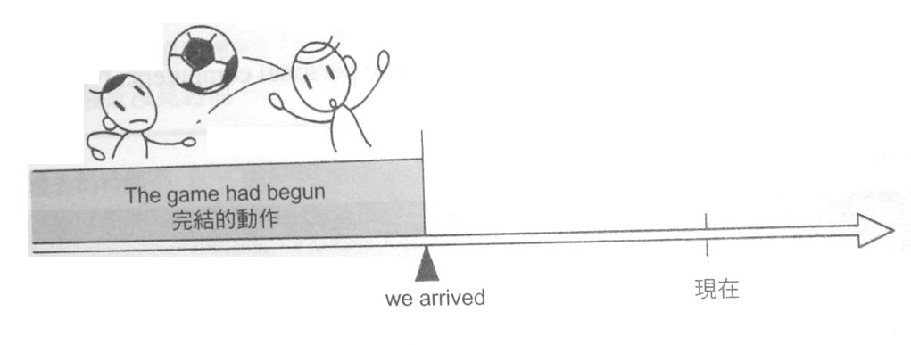
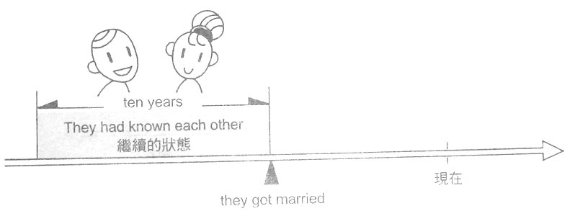
過去完成式
過去完成式是將過去的某個時間點與該時間點以前一起聯想。
形式：「had＋過去分詞」
表示完結或結果 ＊ The game had already begun when we arrived at the stadium.
表示經驗 ＊ I had never spoken to a foreigner before I entered college.
表示持續 ＊ They had known each other for ten years when they got married.

Slide 12
表示兩突發事件時間前後關係
＊ I realized that I had left my umbrella in his car.
會話中常用的縮寫：
I had→ I’d you had→ you’d he had→ he’d she had→ she’d
we had→ we’d they had→ they’d
過去完成進行式
形式：「had＋been＋V-ing」
表示動作持續 ＊ I had been driving for two hours when I found the gas station.

Slide 13
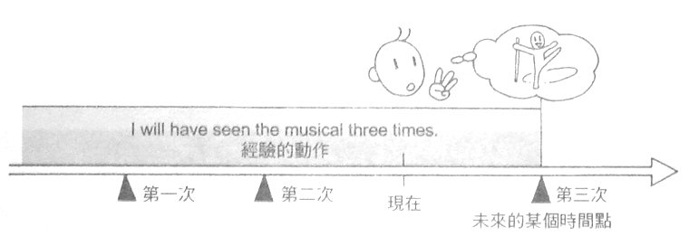
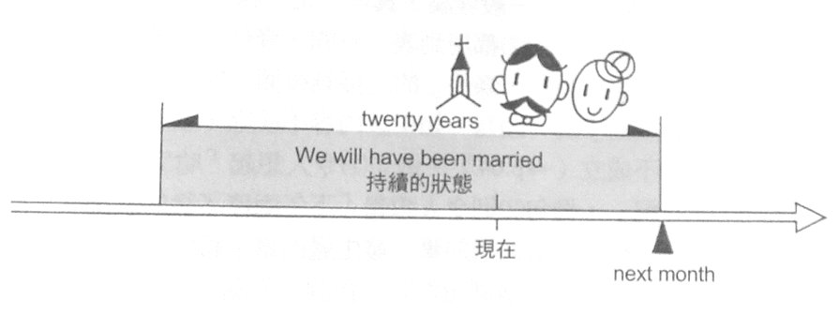
未來完成式
未來完成式用於從現在到未來某個時間點的狀況一直相關時的預測。形式：「will＋have＋過去分詞」
表示完結或結果 ＊ The concert will have finished by three.
表示經驗 ＊ I will have seen the musical three times if I see it again.
表示持續 ＊ Next month we will have been married for twenty years.
未來完成式進行式
形式：「will＋have＋been＋V-ing」
表示動作持續 ＊ Next year I will have been working at the company for 30 years.

